Slide 1
Integrating State Public Policy Resources into Wholesale Markets
Kathleen L. Barrón
Senior Vice President, Competitive Market Policy
June 2, 2017

Slide 2
23

Slide 3
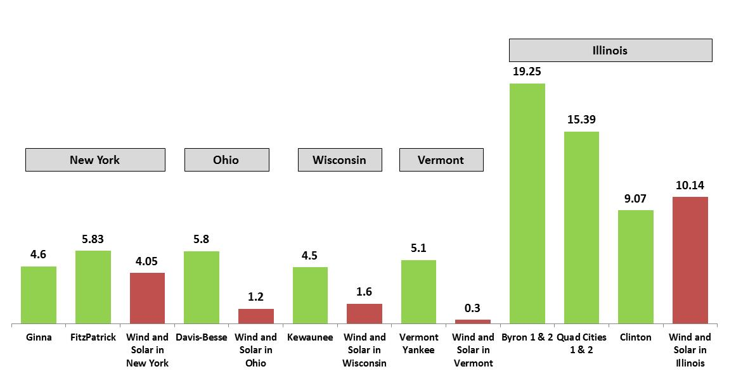
The Challenge of Replacing Nuclear with Renewables
(billions of kilowatt-hours)
In reality, a nuclear plant would never be replaced with renewables because solar and wind are intermittent and non-dispatchable. Nuclear plants are dispatchable and operate 24-by-7. Prematurely retired nuclear is replaced largely by emitting generation.
Following nuclear retirements, electricity demand is met by increased utilization of other resources such as natural gas-fired plants. As the electric grid becomes more dependent on natural gas, the greater use of fossil generation translates to higher wholesale electricity prices. These price increases are reflected in cost increases to consumers.
Source: Energy Information Administration. 2014 data except for Kewaunee (Wisconsin), which is 2012 generation, its last full year of operation
2

Slide 4
Three Mile Island Unit 1 Produces More Zero-Carbon Energy Than All the Renewable Resources in Pennsylvania
In 2015, Pennsylvania’s nuclear plants accounted for 40% of total generation and ~93% of all zero-carbon generation in the state. Its nuclear fleet avoided more than 37 million tons of carbon emissions.

Slide 5
Environmental Attribute Price Comparison
ZEC prices in IL and NY are
Roughly 1/2 of the combined attribute value for PJM wind
Roughly 1/3 of the combined attribute value for PA solar
Roughly 1/16 of the combined attribute value for NJ solar
There is no solar cost or resource advantage of PA over NJ, so if PA decided to spur new solar development then the PA SREC price would likely approach NJ SREC price levels
Notes:
REC prices from 3/3/2017 Platts MWDaily Newsletter
Wind PTC = $23/mwh in 2016; converted to pretax using 1/(1-35%); escalated 2% per year for 10 years; levelized over 25 years at 8% WACC
Solar ITC = 30% ITC; $2000/kw capital, 20 year life, 18% capacity factor, 8% WACC
4

Slide 6
Zero Emission Credits (ZECs) are Like Renewable Energy Credits (RECs)
The NY and IL ZEC programs build on renewable energy credit programs
that exist in the majority of states
Both credits are for environmental attributes to meet a state environmental goal.
Both RECs and ZECs are credits certifying that electricity was created using emission-free technology.
While legal challenges have been filed, we believe that ZECs, like RECs, will withstand legal challenge:
ZECs are “unbundled” from the energy and sold separately and not a charge
in connection with a wholesale sale.
ZECs are payments for the environmental attributes of production not for electricity sold in the wholesale markets.
Payment for ZECs is not “tethered” to action in a FERC jurisdictional market.
MOPRs are a tool to address the exercise of buyer market power by entities seeking lower prices. The clear purpose of ZEC programs is to ensure carbon abatement, not to suppress market prices. Moreover, mitigation has never been applied to an existing resource and applies only to downstate zones in the NYISO. Adverse action by FERC would result in the closure of at least seven units in Illinois and New York.
5

Slide 7
State-supported renewables and traditional regulated generation will be over twice as large as potential nuclear ZEC generation by 2025
59%
48%
48%
Unregulated fossil + imports
Unregulated fossil + imports
Unregulated fossil + imports
Other unregulated nuclear
35%
34%
Other traditional regulated
MA hydro imports
29%
Regulated hydro (NYPA)
Traditional regulated
RPS Renewables
RPS Renewables
RPS Renewables
17%
18%
12%
Other at-risk nuclear
Upstate NY nuclear
Millstone + Seabrook
Quad Cities
PJM
New York
New England
Sources: 2016 ISO-NE CELT Report; 2015 New York Gold Book; 2016 PJM Load Forecast Report; FERC Form 1 filings for investor-owned utilities in PJM and NY; Projected RPS renewables based on existing RPS legislation in various states; MA hydro imports based on 9.45 TWh clean generation procurement target specified in MA H.N. 4568.

Slide 8
A carbon price drives multiple types of carbon reductions in a technology-neutral fashion
Illustrative
…Which drives multiple carbon-reducing processes, via the same market-based price signal
+ Cost of carbon emissions
Variable Fuel cost
Before Carbon
After Carbon
Subsidies/ Nothing
Capacity
Capex
+ Carbon in Energy Price
Capacity
Energy
O&M
Energy
Renewable New Entry Before Carbon
Renewable New Entry After Carbon
Risk
Capacity
+ Carbon in Energy Price
Capacity
O&M
Energy
Fuel
Energy
Nuclear Economics Before Carbon
Nuclear Economics After Carbon
Plus Energy Efficiency and other Demand-Side
7

Slide 9
By moving a portion of compensation to the energy market, a carbon price reduces (or eliminates) need for state support and reduces pressure on nuclear
State Supported Clean Energy Attribute Payments Outside Energy Market
State Supported Clean Energy Attribute Payments Outside Energy Market
Demand (4 MW)
Demand (4 MW)
Nuclear not currently state-supported, but will likely need support in future
Energy clearing price = $61/MWh
$/MWh
$/MWh
Carbon charge to emitting resources remitted to LSEs
Energy clearing price = $40/MWh
Fuel Cost
Fuel Cost
 | Gross Margin (Excluding Capacity):
 | Energy | Attribute | Carbon | Fuel | Total
Wind | 40 | 35 | 0 | 0 | 75
Nuclear | 40 | 0 | 0 | (10) | 30
Gas CC | 40 | 0 | 0 | (30) | 10
Gas CT | 40 | 0 | 0 | (40) | 0
 | Gross Margin (Excluding Capacity):
 | Energy | Attribute | Carbon | Fuel | Total
Wind | 61 | 14 | 0 | 0 | 75
Nuclear | 61 | 0 | 0 | (10) | 51
Gas CC | 61 | 0 | (16) | (30) | 15
Gas CT | 61 | 0 | (21) | (40) | 0

Slide 10
Illustrative Consumer Impact in PJM
$17/MWh
$8.5/MWh
Illustrative
$1/MWh
$2/MWh
$0.5/MWh
$3.5/MWh
$1.5/MWh
($0.5)/MWh
Assumptions: 0.795 short ton per MWh marginal emission rate; 0.39 short ton per MWh average emission rate; baseline REC price of $10/REC. Current at-risk nuclear assumed to include Quad Cities, Byron, TMI, Davis-Besse, Perry, Beaver Valley, Susquehanna, Salem and Hope Creek.

Slide 11
Appendix

Slide 12
NY Clean Energy Standard/Zero Emission Credit Program
Purpose of ZEC Program
“The intent of the ZEC program is to preserve the zero-emissions attribute benefits of the [nuclear] facilities to prevent backsliding in the State's carbon reduction performance that likely could not be avoided in any other way.” CES Order at 145.
General Structure
Builds on well-established REC programs to “properly value[]” the “emission-free attributes from eligible operating nuclear generating plants.” CES Order at 119.
A ZEC reflects “the zero-emissions attributes of one megawatt-hour of electricity production”
ZECs will be sold by eligible generators to NYSERDA, and all LSEs will be required to purchase ZECs from NYSERDA annually in proportion to their load ratio share.
Contract term: 12 years, made up of six two-year tranches.
Program designed to accommodate future federal zero emissions programs.
Eligibility Requirements: Finding of “Public Necessity”
Verifiable historic contribution of facility to NY clean energy resource mix.
Wholesale revenues inadequate to preserve the zero-emission attributes.
Costs and benefits relevant to other alternatives.
Ratepayer impact & public interest.
Ginna, Nine Mile Point, and FitzPatrick found eligible for first tranche; other nuclear potentially eligible for future tranches.

Slide 13
New York CES – ZEC Pricing Mechanism
Overview
Value based on social cost of carbon by USIWG, but can be adjusted downward after first two years to account for forecasted increases in energy and capacity prices, thereby protecting consumers if electricity prices are forecasted to rise.
ZEC Formula
SCC – (Baseline RGGI Effect) – (Energy + Capacity Forecast in Excess of $39/MWh)
Elements of Formula
SCC is based on values developed by USIWG in 2015 and escalates over six, two-year tranches.
Baseline RGGI Effect is intended to avoid double counting RGGI and is set for all tranches at $10.41/short ton.
The Forecast Energy & Capacity Price Change Adjustment can reduce the ZEC price below the SCC if energy and capacity prices are forecasted to rise above $39/MWh. Energy forecasts are based on ICE futures for NYISO Zone A. Capacity forecasts are based on NYMEX futures for rest-of-state.
ZEC Price -- $17.48/MWh for first two-year tranche.
ZEC Value – Formula caps the ZEC value at the social cost of carbon, which ensures price remains a substantial discount to RECs.
ZEC Cost -- $17.48/MWh x 27.6MMWhs = $483M/yr
Cost/Benefit – Compare to $940M/yr replacement cost of nuclear (replacement RECs and new capacity construction)

Slide 14
Illustration of ZEC Pricing
(Illustrative) | Upstate ZEC Price based on SCC ($/MWh) | Zone A Reference Price ($/MWh) | Forecast Zone A Energy plus ROS Capacity Price ($/MWh) | Zone A Reference Price minus Forecast ($/MWh) | Resulting Upstate ZEC price ($/MWh)
Example 1: Market prices increase per price forecast used in DPS staff Cost Study
4/17 – 3/19 | $17.48 | NA | NA | NA | $17.48
3/19 – 3/21 | $19.59 | $39 | $56 | ($17) | $2.59
4/21 – 3/23 | $21.38 | $39 | $64 | ($25) | $0.00
4/23 – 3/25 | $23.56* | $39** | $69 | ($30) | $0.00
4/25 – 3/27 | $25.00* | $39** | $75 | ($36) | $0.00
4/27 – 3/29 | $26.26* | $39** | $78 | ($39) | $0.00
Example 2: Market prices decline (same price as if market prices remained flat)
4/17 – 3/19 | $17.48 | NA | NA | NA | $17.48
3/19 – 3/21 | $19.59 | $39 | $38 | $0 | $19.59
4/21 – 3/23 | $21.38 | $39 | $37 | $0 | $21.38
4/23 – 3/25 | $23.56* | $39** | $36 | $0 | $23.56
4/25 – 3/27 | $25.00* | $39** | $35 | $0 | $25.00
4/27 – 3/29 | $26.26* | $39** | $34 | $0 | $26.26
* Assumes that the Social Cost of Carbon $/ton to $/MWh conversion factor is reduced starting in tranche 4 as per page 136-138 of the CES Order based on assumed renewables of 51.23 TWh in 2022, 56.06 TWh in 2024, and 60.87 TWh in 2026. If actual achieved renewable generation is different than these assumed amounts, the ZEC price will be different than shown here. ** The Zone A Reference Price for tranches 4 through 6 assumes that the energy basis adjustment described on pages 140-141 of the CES Order does not result in a adjustment to the Reference Price.

